Slide 1
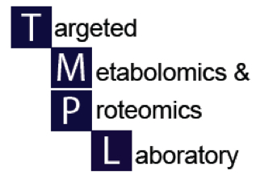

Metabolomics and the NIH Common Fund
UAB Metabolomics Symposium
December 12, 2012
Stephen Barnes, PhD
Professor of Pharmacology & Toxicology

Slide 2
Direction of NIH Research 1950-2012
Metabolomics
1950s-60s emphasis on determining metabolic pathways – 20+ Nobel prizes
1950s-early 1980s Identification and purification of proteins
1995-present Omics galore
Transcriptomics (microarray, deep sequencing, RNA seq)
Proteomics
1980-1988 Sequencing of genes – cDNA libraries –orthogonal research
2012 Human genome ENCODE project reveals the extent of DNA expression and roles for “junk DNA, as well as intergenic proteins
1988-2000 Sequencing of the human genome – period of non-orthogonal research – ?junk DNA
Sequencing of genomes of common experimental models
2006 First ENCODE project on 1% of the human genome reveals RNAs coming from more than one gene
2005 Tiling arrays reveal that there is far more expressed RNA than mRNA

Slide 3
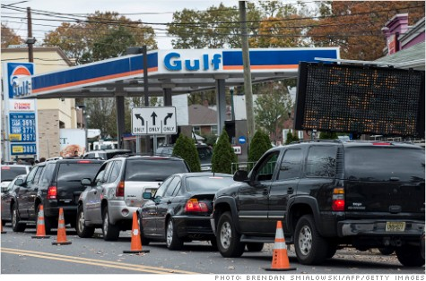
World without gas!

Slide 4
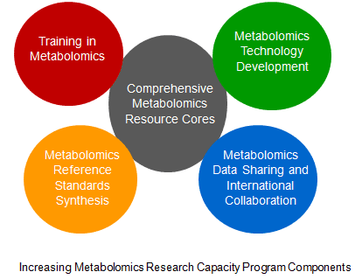


NIH Metabolomics Program

Slide 5
NIH Investments 2004-2009
Metabolomics Technology Development Initiative
  2004 Funded 14 investigators
    Matson (VA Bedford, MA), Hill (Washington St), Griffin (U. Cambridge), Brown (Columbia), Sweedler (UIUC), Sussman (RTI), Regnier (Purdue), Wagner (Harvard), Dovichi (Notre Dame), Breaker (Yale), York (Duke), Kleinfeld (Torrey Pines), Liao (UCLA), Brunengraber (Case Western)
Development of a plasma metabolomics standard
  NIST-NIH interagency project
  Available to NIH investigators
Investment in pathway analysis
  2006 Funded 8 investigators – 6 ICs provided funding
    Cravatt (Scripps), Freyer (U New Mexico), Han (Burnham-Florida), Rabinowitz (Princeton), Sweedler (UIUC), Burant (Michigan), Frommer (Carnegie Inst), Dovichi (Notre Dame)

Slide 6
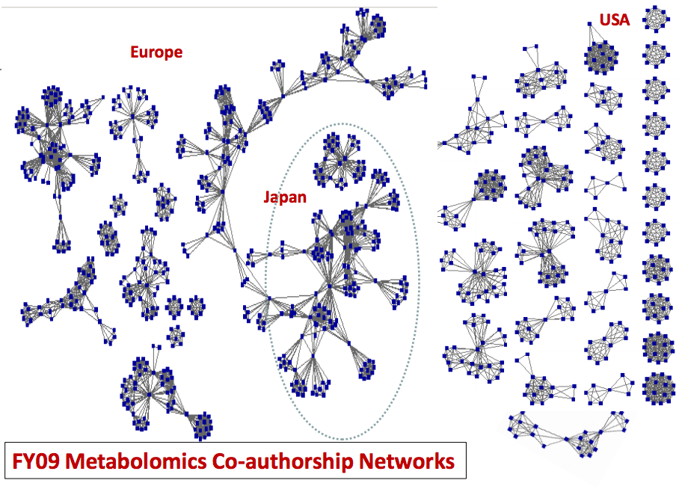

Slide 7
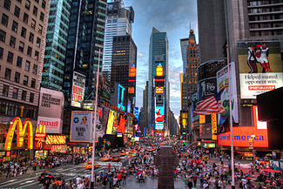
What is the metabolome?

Slide 8
What is the metabolome?
Metabolites synthesized from small molecule precursors by human cells
Pharmaceuticals including antibiotics that alter and are altered by the microbiome
Metabolite pool in tissues and biofluids
Exogenous compounds coming from the diet, including those in common with human metabolites
Metabolites arising from commensal bacteria in the human gut (and other microbiomes)
Metabolites specific to invasive, infecting microorganisms
Environmental chemicals and toxins

Slide 9
Funded metabolomics grants (2012)
Metabolomics Data Repository and Coordinating Center
  “The Metabolomics Data Center and Workbench (MDCW)”
  Shankar Subramanian, UCSD
Development of Courses or Workshops in Metabolomics
  “UAB Metabolomics Workshop: from design to decision”
  Stephen Barnes, UAB
− “Online learning platform: introducing clinicians and researchers to metabolomics”
− Martin Kohlmeyer, UNC-Chapel Hill

Slide 10
UAB Metabolomics Workshop
The first workshop will be held July 22-25 in 2013
  There will be 20 slots
  Those wishing to take part will need to apply
    We will alert today’s symposium attendees by e-mail
  We will select those with the strongest rationalization
    The focus will be on those who will be using metabolomics
In 2014 the workshop will be expanded to 40-50 participants and be opened to all comers

Slide 11
Common Fund Metabolomics grants
Regional Comprehensive Metabolomics Resources
  Michigan Regional Comprehensive Metabolomics Resource
  Charles Burant, University of Michigan, Ann Arbor
  West Coast Central Comprehensive Metabolomics Resource
  Oliver Fiehn, UC-Davis
  RTI's Regional Comprehensive Metabolomics Resource Center
  Susan Sumner, Research Triangle Institute

Slide 12
Common Fund Metabolomics grants
Technology development for large scale metabolomics
Erin Baker (Battelle Pacific Northwest)
  Platform for high throughput and sensitivity
Teresa Fan (U. Louisville)
  Integrated chemoselective and informatic platform
Jian Hu (Battelle Pacific Northwest)
  Slow magic angle spinning NMR
Bob Murphy (UC-Denver)
  Lipidomics by MALDI/ion mobility mass spectrometry
Andrew Patterson (Penn St)
  Optimized metabolite extraction
Gary Patti (Wash U)
  Untargeted metabolomics workflow

Slide 13
NIH Common Fund – Metabolomics [FOAs 2012 & 2013]
Technology Development to Enable Large Scale Metabolomics Analyses (R01 RFA-RM-11-019)
Regional Comprehensive Metabolomics Resource Cores (RCMRC) [U24 RFA-RM-11-016, Feb. 15, 2013]
Development of Courses or Workshops in Metabolomics (R25 RFA-RM-11-018)
Mentored Research Scientist Development Award in Metabolomics (K01 RFA-RM-11-017) [K01-RFA-12-025, Feb. 28, 2013]
Administrative Supplements for Collaborative Activities to Promote Metabolomics Research (NOT-RM-11-024) RFA-12-?]

Slide 14
Symposium outline
Chris Newgard (Duke U)
  Overview of metabolomics and its applications
Grier Page (RTI Intl)
  Designing a metabolomics experiment
Andrew Patterson (Penn St)
  Using Metabolomics to Understand Valproate-Induced Obesity in Pediatric Patients with Epilepsy
Elizabeth Kensicki (Metabolon)
  Conducting untargeted metabolomics
Manfred Spraul (Bruker)
  Clinical applications of NMR in metabolomics
Lunch and focused expert Q&A
Brigitte Simon (AB-Sciex)
  SWATH-MS and metabolomics
David Wishart (U. Alberta)
  Using Metabolomics to Discover Novel Biomarkers for Common Diseases
Short Metabolomics Presentations
  Kabarowski, Lund, Singh, Sudarshan

Slide 15



Acknowledgements
UAB School of Medicine/CCTS
Comprehensive Cancer Center
Center for Free Radical Biology
Comprehensive Cardiovascular Center
Comprehensive Diabetes Center
Diabetes Research and Training Center
Nutrition Obesity and Research Center
O’Brien Acute Kidney Injury Center
NIH Common Fund R25 GM103798-01

